Slide 1
Why NG-tax?
An increasing number of studies have shown that the chosen methodology rather than the natural variance is responsible for the greatest variance in microbiome studies

Slide 2
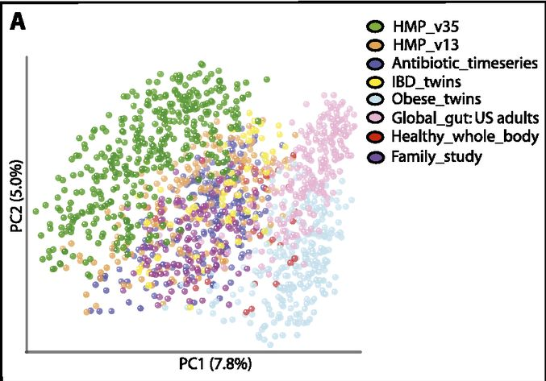
Meta analysis
Catherine A. Lozupone et al. Genome Res. 2013;23:1704-1714

Slide 3
Objective
Accuracy of taxonomic classifications
Quantification potential (abundance)
Estimate true richness/diversity
Compare performance of 2 regions (V5-V6, V4)

Slide 4
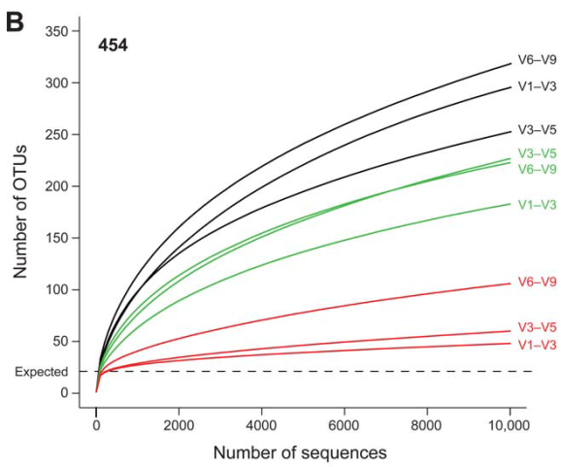
Evaluation of 16S rDNA-based community profiling for human microbiome research (jumpstart consortium human microbiome project data generation working group, Plos 2012)
unfiltered
Quality filtering
4x
2x
Chimera + quality filtering
1.5x
“improved estimation of community diversity after quality filtering and chimera checking”
Notes:
Inflated alpha diversity curves, with pyrosequencing of a 36 OTU MC. The lines don’t flatten even with quality filtering.

Slide 5
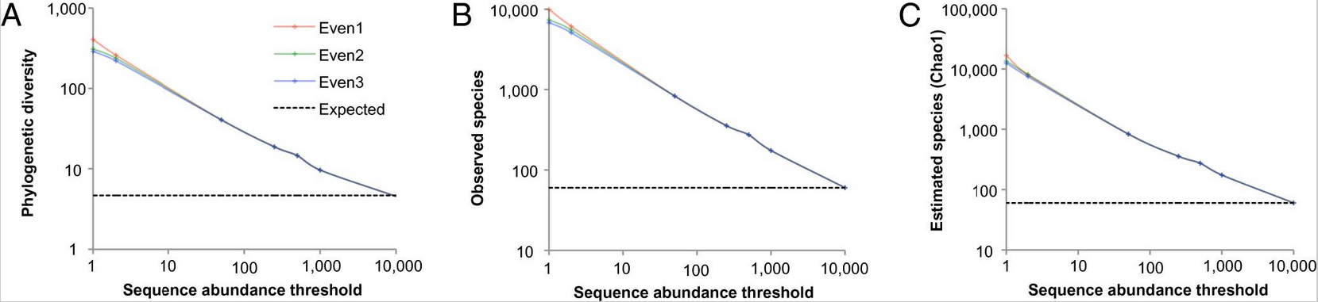
Global patterns of 16S rRNA diversity at a depth of millions of sequences per sample (Caporaso, Pnas 2010)
‘Correct’ flawed data
Sequence abundance threshold
Notes:
They applied a sequence abundance threshold of 85.000 reads (an OTU needs >85.000 reads to be considered real). They established this using different alpha diversity-metrics.

Slide 6
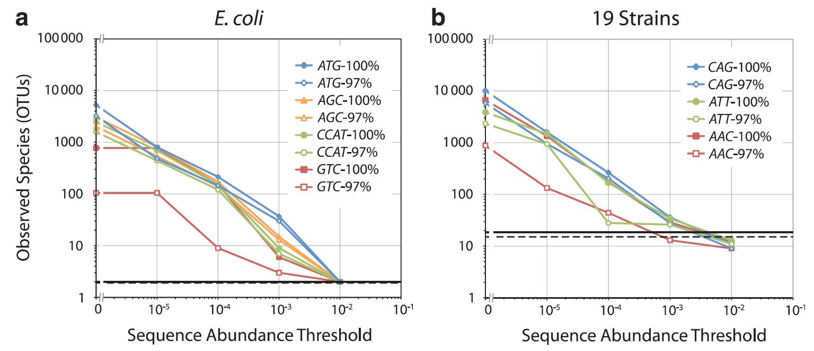
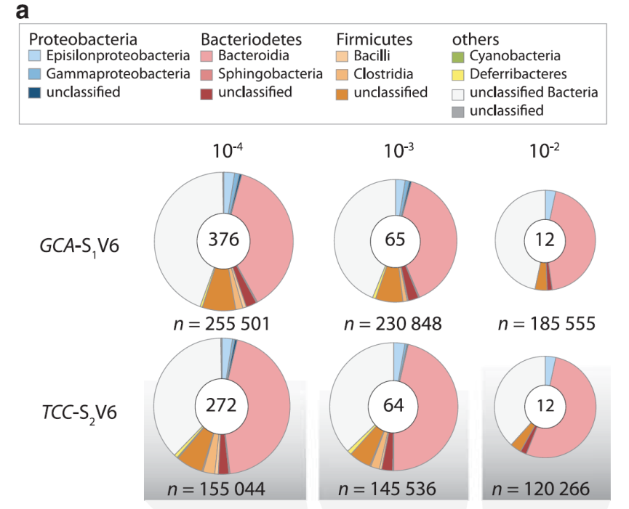
Illumina-based analysis of microbial community diversity Degnan & Ochman, 2011, Isme j)
?
Notes:
The authors used the same read abundance threshold approach, to correct for inflated OTU numbers. They used 2 mock communities; E. coli (3 OTU’s) and a 19 strain one. However the read abundance threshold changed with the complexity of the mock community. When they tried to applied the read abundance thresholds from the MC’s to a biological sample (mouse) they observed too little OTU’s.

Slide 7
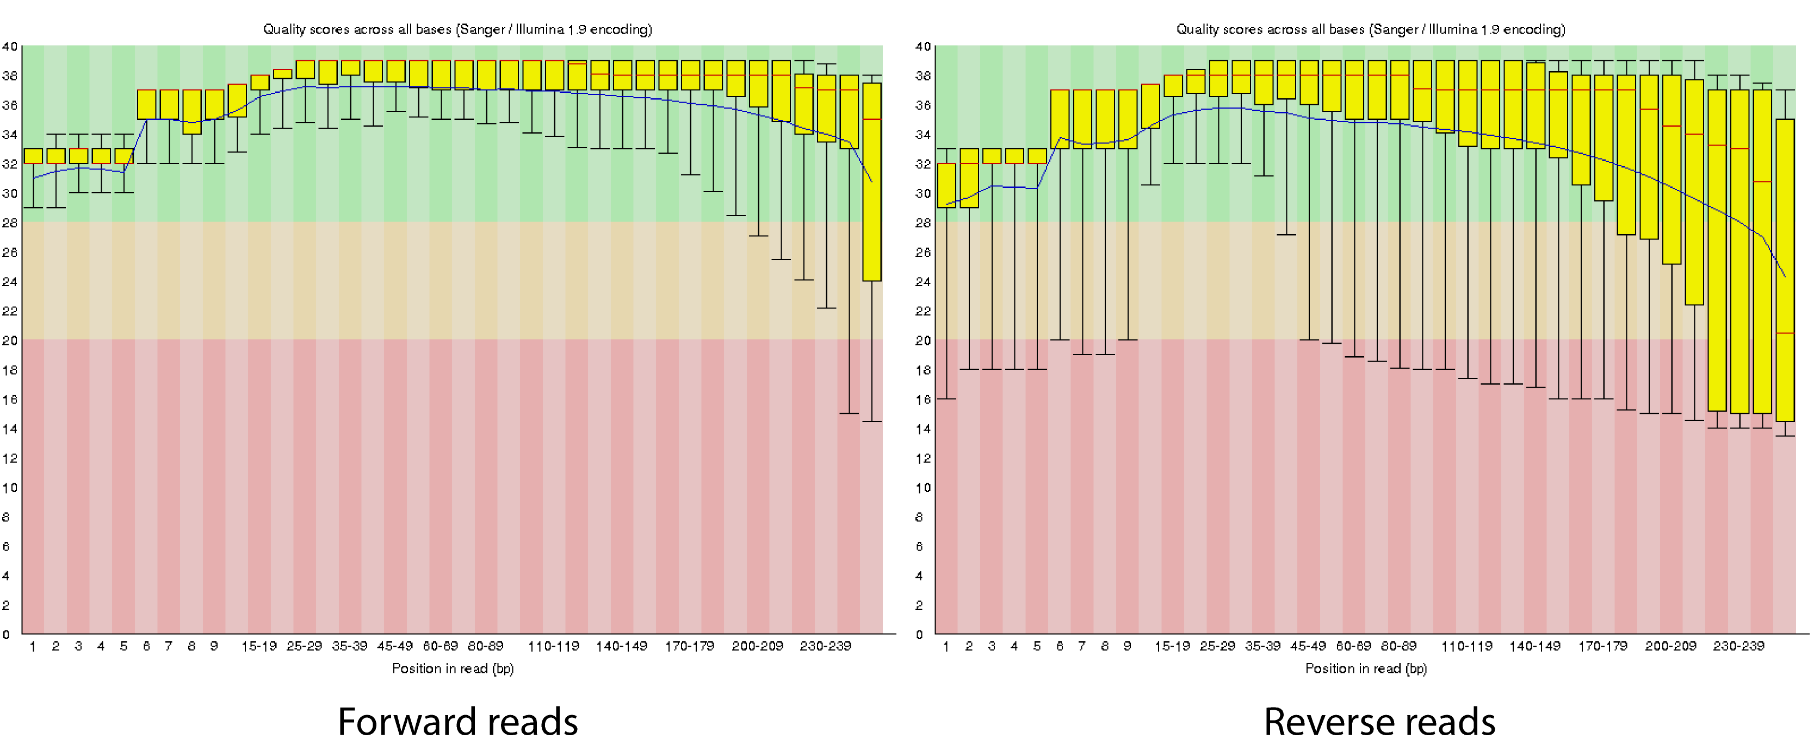
Identification vs Composition
Default = optimal
Optimum between length (resolution) & quality (repeated sequences)
Phred 10 = 90% accuracy, 30 99.9%

Slide 8
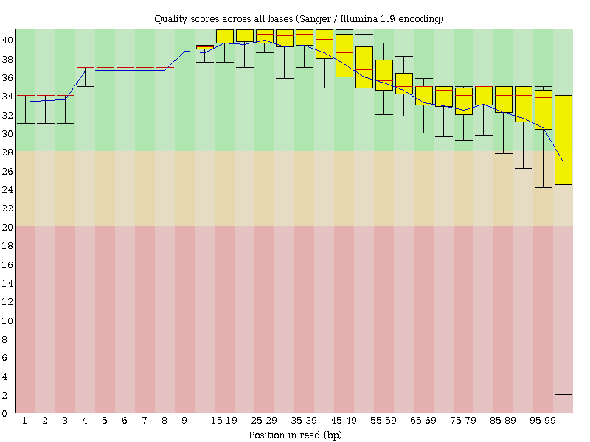
Sequencing quality: the truth
 | Old library 4 | % | New Library 4 | %
Both invalid barcodes* | 80483 | 4.2 | 7137707 | 12.9
Only one valid barcode | 560049 | 29.4 | 15224394 | 27.6
Both valid barcodes but not matching | 884080 | 46.4 | 5326330 | 9.7
Both valid barcodes and matching | 379231 | 19.9 | 27476627 | 49.8
Total | 1903843 | 100 | 55165058 | 100
>99.9% accuracy
40-70% error in primer and/or barcode (1/3th read)
26-40% error in the barcode region (1/10th)
10-50% matching barcodes

Slide 9
Sequencing quality: biology
Sequencing error is not random(ly distributed)
Evaluation of 16S rDNA-based community profiling for human microbiome research (jumpstart consortium human microbiome project data generation working group, Plos 2012)
Unraveling the outcome of 16S rDNA –based taxonomy analysis through mock data and simulations
Bioinformatics 2014, May et al.

Slide 10
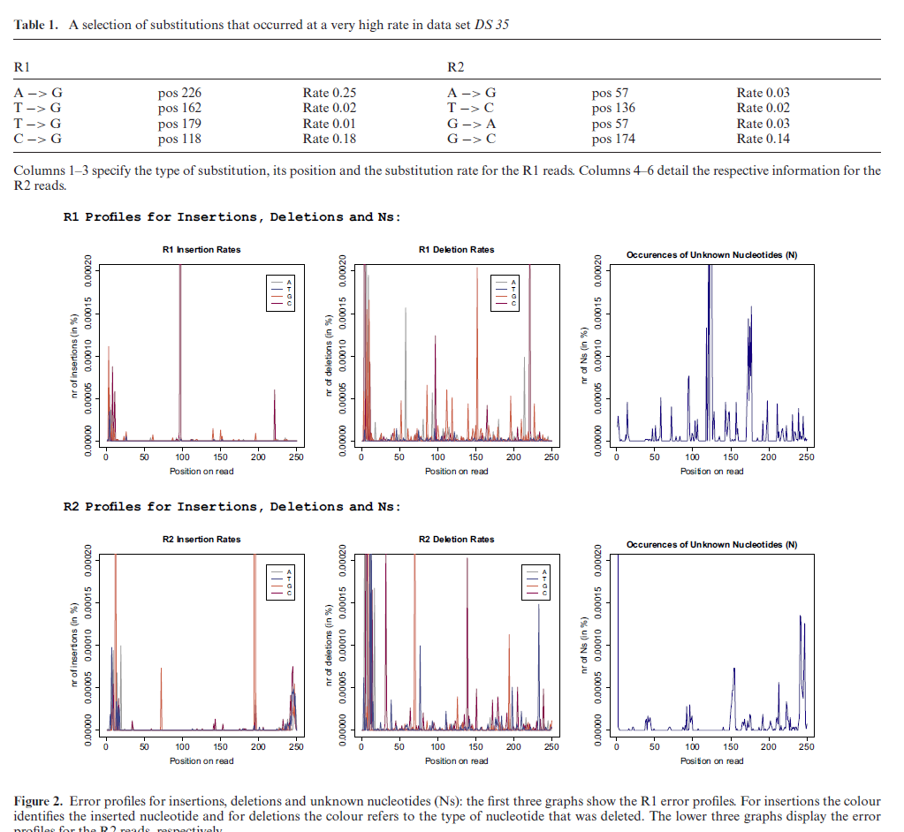
Illumina base-caller specific error
Schirmer, Insight into biases and sequencing errors for amplicon sequencing with the Illumina MiSeq platform, 2015

Slide 11
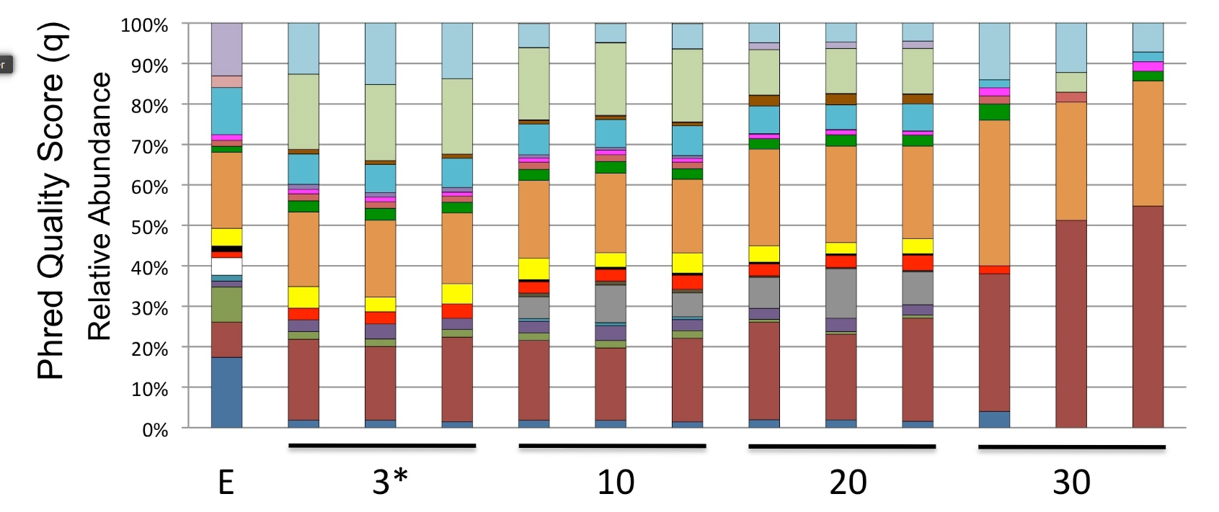
Effect of quality filtering
Bockulich 2013, Quality-filtering vastly improves diversity estimates from Illumina amplicon sequencing, supplementals

Slide 12
Filtering based on quality good idea?
Known/’improve’
Unknown/no control whatsoever
PCR (high fidelity polymerase)
Little cycles=less chance of error
1 PCR (2nd step PCR=~50% don’t contain barcode)
Sequences in your sample (primer dependent)
Illumina base-caller (improve with PhyX and equal base distribution of barcodes?)

Slide 13
Optimal settings
No quality filtering
Filter by abundance -> high quality
‘Short’ reads (enough for identification) = less chance for error

Slide 14
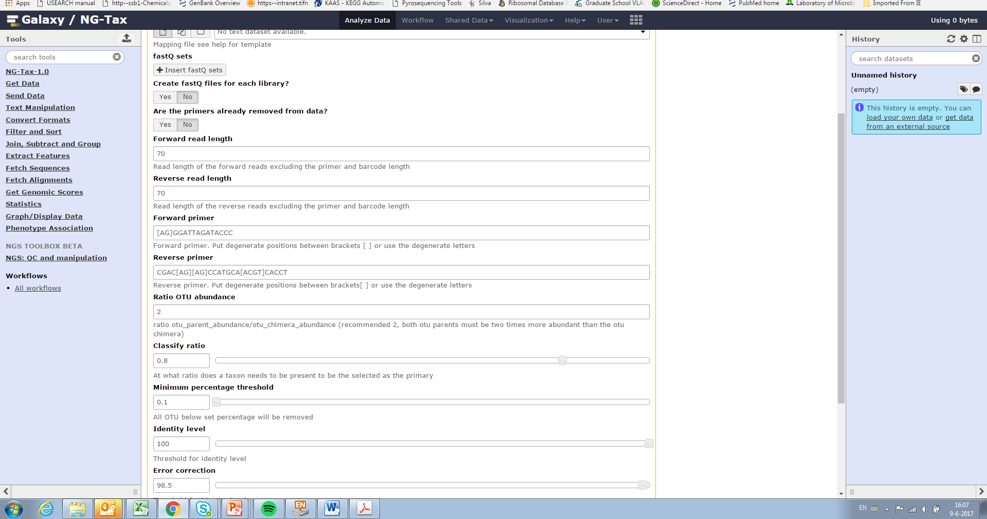

Slide 15
Threshold determination
Sample
Abundance threshold
Sequence | Counts | Accumulated counts | Counts /Accumulated counts > 0.001
TACTATGCCA | 658 | 658 | 658/658>0.001 Yes
GTCTAGTACA | 523 | 1171 | 523/1171>0.001 Yes
... | ... | ... | ...
GTATTAGCCA | 75 | 74560 | 75/74560>0.001 Yes
GTCTATGCCA | 72 | 74632 | 72/74632>0.001 No
ATCTATGCCT | 70 | 74701 | No
... | ... | ... | ...
CTTTACGCCT | 1 | 159240 | No
Sample 1
Order reads by abundance
Read abundance table
Set Abundance threshold 1

Slide 16
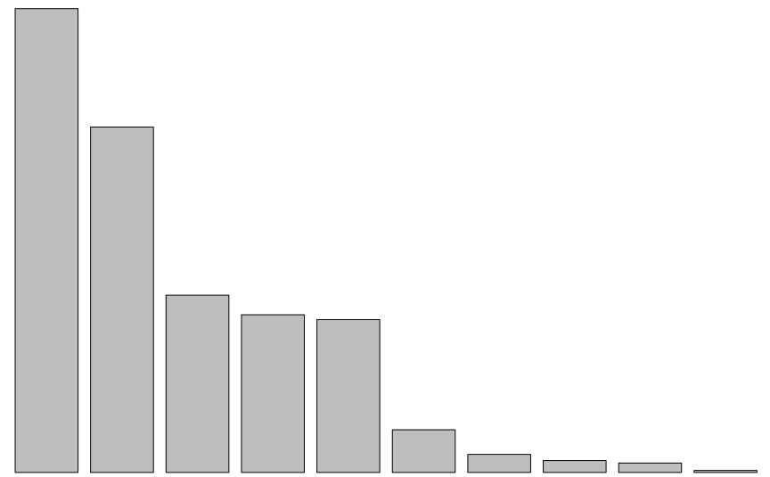
OTU selection (per sample)
Create unique OTU list
Rank by abundance
Abundance threshold
Above threshold included
Below threshold rejected
99.9%
of total reads
0.1%
of total reads
Count
OTU#

Slide 18
Chimera filtering
Forward
Reverse
Only accepted OTU’s
The filtering
2x threshold
H is chimera of B & D
A
> 2x
A
B
B
C
> 2x
C
Sorted by abundance
D
D
E
E
2x threshold
F
F
G
G
H
H

Slide 20
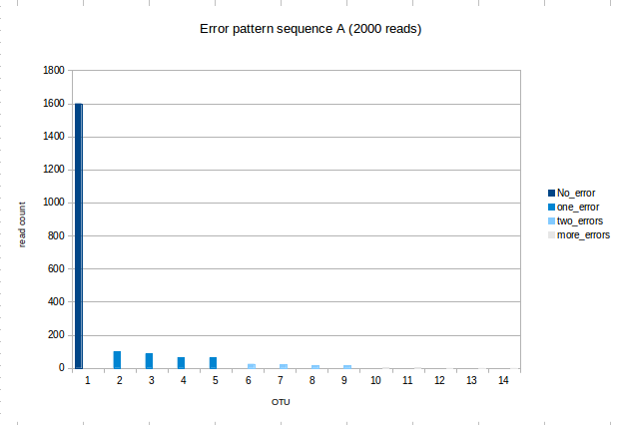
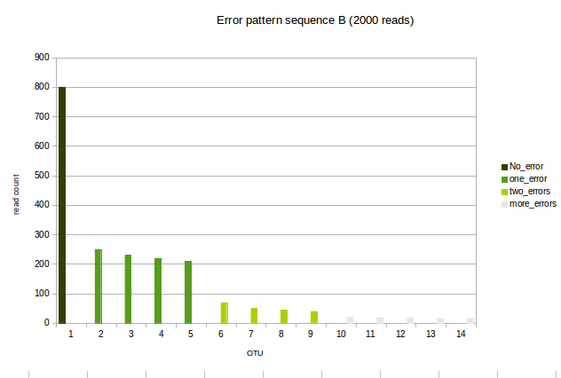
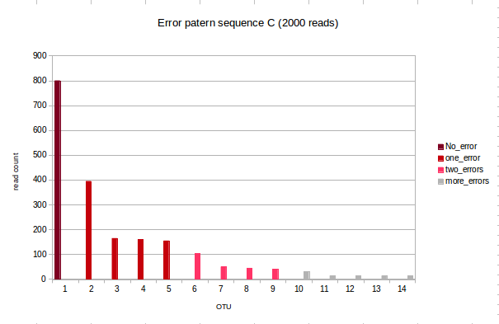
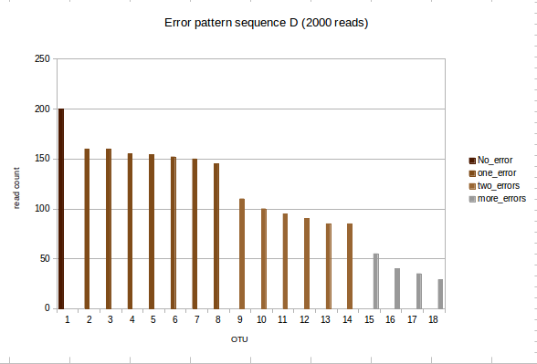
Error pattern is sequence-specific
In some extreme cases the error rate is that high that recover the OTU is impossible

Slide 21
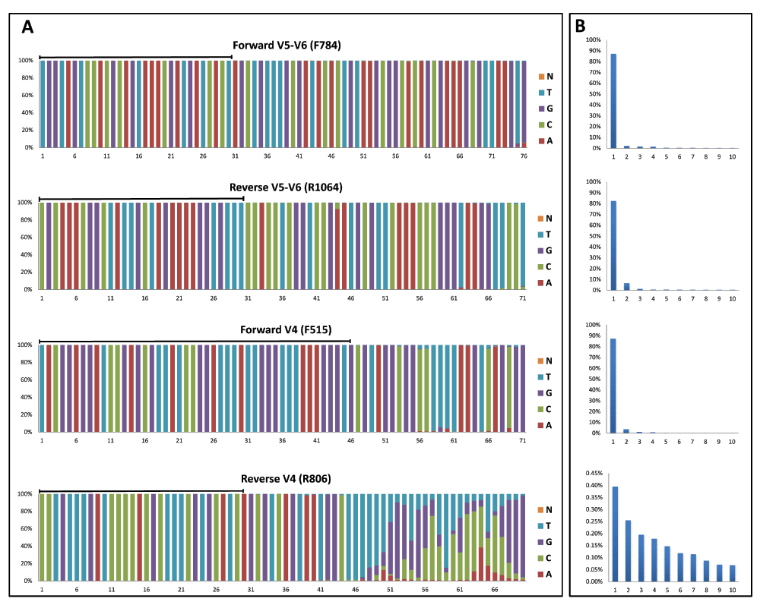
Example of unknown ‘things’: in silico ≠ in vitro Parabacteroides

Slide 22
Error correction
Correction of abundance profiles
For each rejected Otu
Find most abundant accepted OTU with 1 mismatch
Add count of rejected OTU to the count of accepted OTU
Count
OTU#

Slide 23
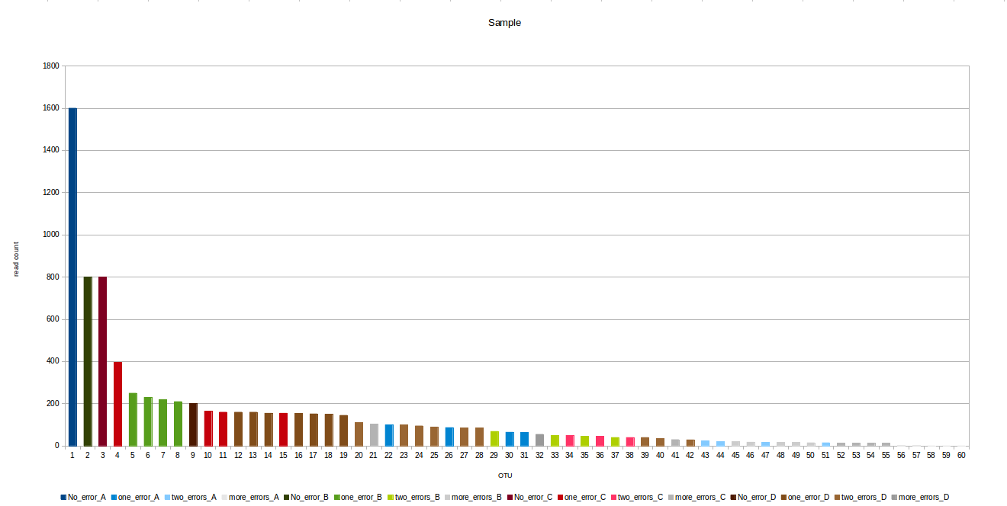
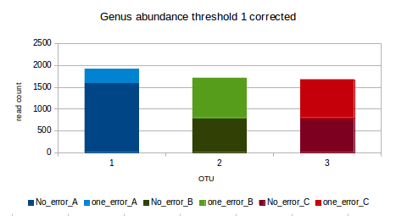
Abundance determination step allowing one mismatch -> correct for differential error pattern and reduce the impact of the abundance threshold
Sample with equimolar Blue, Green, Red and Brown genera
Before correction -> dark color
“Blue” genus >> “Green” genus = “red” genus
After correction -> added light color
“Blue” genus ≈ “Green” genus ≈ “red” genus
*
Threshold 1
* Reads before, valid OTUs
*
*
* Reads after allowing one mismatch
*
*
*
*
*
*
*
*
*
*
*
*

Slide 24
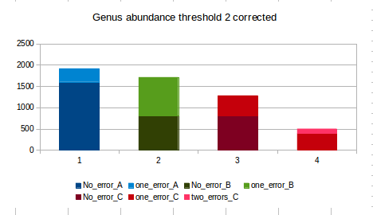
Abundance determination step allowing one mismatch -> correct for differential error pattern and reduce the impact of the abundance threshold
Sample with equimolar Blue, Green, Red and Brown genera
Before correction -> dark color
“Blue” genus >> “Green” genus < “red” genus
After correction -> added light color
“Blue” genus ≈ “Green” genus ≈ “red” genus
*
Threshold 2
* Reads before, valid OTUs
*
*
* Reads after allowing one mismatch
*
*
*
*
*
*
*
*
*
*
*
*
*

Slide 25
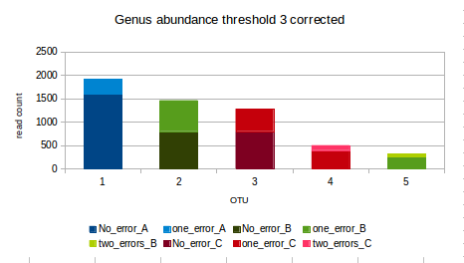
Abundance determination step allowing one mismatch -> correct for differential error pattern and reduce the impact of the abundance threshold
Sample with equimolar Blue, Green, Red and Brown genera
Before correction -> dark color
“Blue” genus ≈ “Green” genus ≈ “red” genus
After correction -> added light color
“Blue” genus ≈ “Green” genus ≈ “red” genus
*
Could be a lot of OTUs... Or not depends on error rate= not biology
Threshold 3
* Reads before, valid OTUs
*
*
* Reads after allowing one mismatch
*
*
*
*
*
*
*
*
*
*
*
*
*
*
Notes:
In conclusion say that small changes in the threshold do not make huge impact in the genus profile since it is corrected by this step. Moving the threshold could increase the number of OTUs but if we use weighted and phylogenetic distance for the diversity, the diversity will be the same since the otus added are small and similar (only one to the previous ones)
After correcting the genus profile take into account the differential error rate, this improve the accuracy of the profiles.
In some weird cases like parabacteriodes in region V4 (that read contains the sequence CCCGC that make crazy the machine) the error rate can be that high that you cannot pick it anymore. But I have a trick to detect this weird cases, check the forward and reverse reads separately, normally the CCCGC sequence is only in one read, so one of the reads should be abundant enough to detect it.
Read discarded are not taken into account for calculating abundance
An OTU present in sample A can be:
Present in B as valid OTU (above the threshold)
Present in B but under the threshold (in principle is ignored, we do not know if is really present of in product of leakage from another samples like 40)
Not present ( This lead to the same problem, is not present because if not present or because the coverage is not depth enough to detect it)
In the last two cases is better to say that we cannot distinguish is something is present in less than 0.1%
I know that this is not ideal but we cannot do anything, claiming that it is or it is not is equally risky.

Slide 26
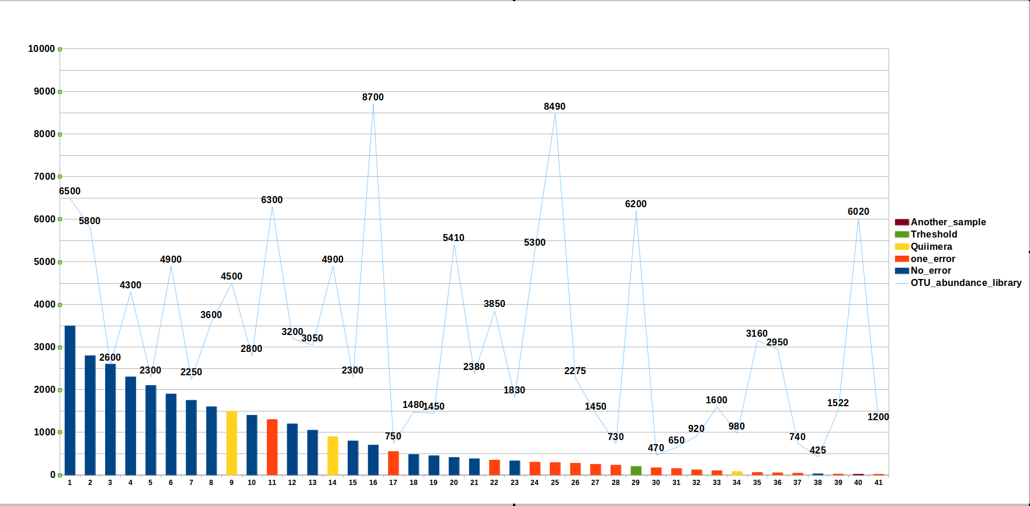
Manual OTU manipulation (for instance QIIME) OTU distribution per dataset (add samples/different results)
Qiime abundance threshold set by library
OTUs present in the sample (our method)
OTUs present in the sample (Qiime)
Notes:
OTUs present in the sample with our method -> from 1 to 28
We can miss real otus like the 38, but going down with the threshold will include 8 non real otus (29-37). In addition there is leakage from other samples and you have OTUs like the 40 that come from another sample, if you go too down with the threshold you can accept as valid OTUs that come from other samples messing your data
OTUs present in Qiime -> 1,2,4,6,8-14, 16,20,22,29,35,36,40
The abundance threshold is set by library, so even if a OTU is important in an specific sample like 3 and 5 you can miss it because this OTU is only present in one sample (“presence in at least two samples” rule) like 3 or because it is not so abundant in the library (like 5, 7 or 15).
You analyse your sample in another library and the results and the list OTU present in your sample changes!!! OTU definition per sample is a must!!!!!!!!!!!

Slide 27
Overview pipeline
Mapping file
Chimeras
FastQ files
Filtered fastQ files
Find OTUs
User input
Rejected OTUs
Classify OTUs
Biom file
(16S) database
Specific (16S) database

Slide 28
NG-Tax OTU picking Most abundant sequence picking feature picking ASV picking from amplicon NGS data (repeated features from very noisy data) (You can use it without a database)
Per sample (independent of the dataset or other samples). Replicability
Independent of sequencing depth
sample composition/distribution (diversity) (correct for sequencing specific error)
Independent of region (removing noise)
No arbitrary ‘filtering’ parameters. reproducibility

